Slide 1
Student engagement in practical assessment
Derek A Scott, Jack Kirkman, Cameron Malcolm, Alison McE Jenkinson
Institute of Education in Medical & Dental Sciences, School of Medicine, Medical Sciences & Nutrition, University of Aberdeen

Slide 2
Background
Need for a rigorous final year practical experience
Assess students from a wide variety of different backgrounds
Assess skills that are not the usual focus of our teaching and learning activities
Curriculum Reform and demonstration of Graduate Attributes and Employability skills
Staff succession planning
Preparation for Honours projects/job interviews/employment
Involvement of students in improving what we do

Slide 3
Introduction of the Objective Structured Practical Examination (OSPE)

Slide 4
OSPE Assessments
Used commonly in clinically-related education for a long time
Multi-station assessments where students rotate round the stations to perform tasks
Avoids need for lengthy written pieces of work
Can design stations to suit tasks, skills or types of students you want or need to assess
We introduced them gradually and were overwhelmed by positive comments in course feedback from students and staff, and wider demand from students who wanted their discipline to adopt them
‘I want to show I’m good at things other than writing essays, lab reports and doing MCQ’s’

Slide 5
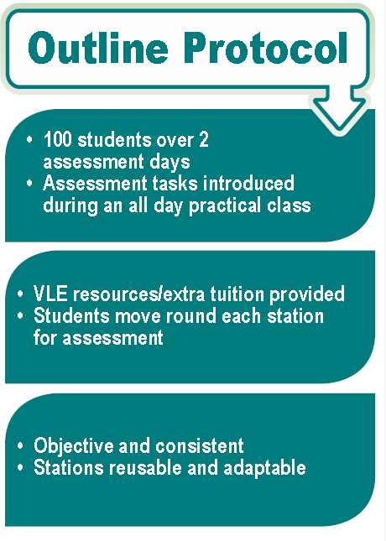
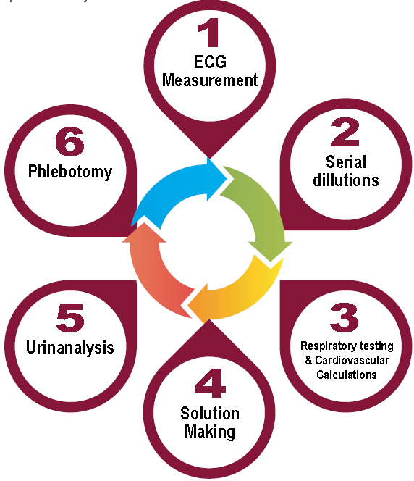
Problem Solving
Interview Skills
Manual Dexterity
Entrepreneur-ship
Numerical Skills
Language Skills
Time Manage-ment
Interpretation
Text
Graphs
Images
Leadership Skills
Situation Awareness
Handling Difficult Situations
Ethics
Health and Safety
Notes:
Time management, Task management, Professionalism, Self motivation, adaptability
Negotiation skills?, team working?
OSPE Overview
Objective Structured Practical Examinations - assess theoretical, practical and problem-solving skills at multiple stations.
Marking criteria structured and published in advance.
Students receive the same test and interaction with different examiners.
Six stations, each assessing a mixture of different skills.
Would this method be suitable to assess Honours sciences students in practical and communications skills?
Is it an efficient method to assess a large Honours class and provide timely and USEFUL feedback?

Slide 6
Communication Skills (10 mins)
Phlebotomy – a new practical skill for majority of students
Students interact with examiner assuming they are a research study volunteer
Enables assessment of ethical approach, communication skills, H&S, using sharps– ALL whilst undertaking a new task (taking a blood sample)
Marking scheme (positive and negative marking) published in advance
Moved from paper marking system to iPad after 1st year to enhance feedback
Review of marking scheme to improve consistency between examiners

Slide 7
How do we deal with more students without spending hours practicing beforehand?

Slide 8
Student-led production of videos to demonstrate what is expected at each station
Suggested by students in feedback
Allowed students to be more flexible in their timetables
Staff didn’t have to spend a couple of days undertaking practice sessions – now only 2 hours scheduled practice time, but students could optionally sign up for more if they wanted it
Videos created by two students during funded summer research project
Only used free software and mobile phones to produce videos
Video content checked by academic and technical staff, style piloted with small group of students to check that were pitched at appropriate level

Slide 9
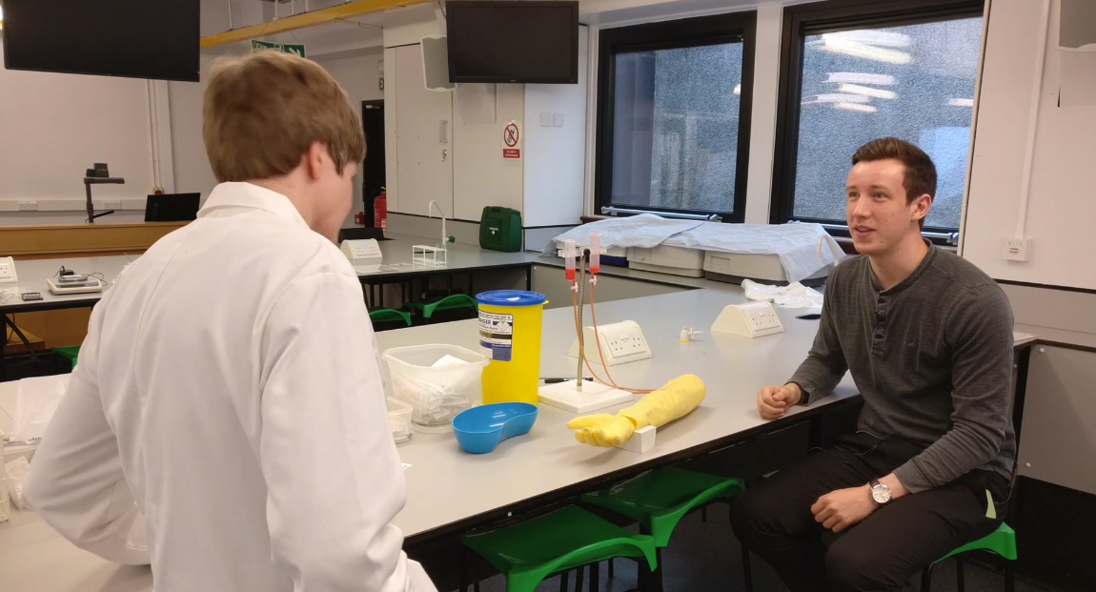

Slide 10
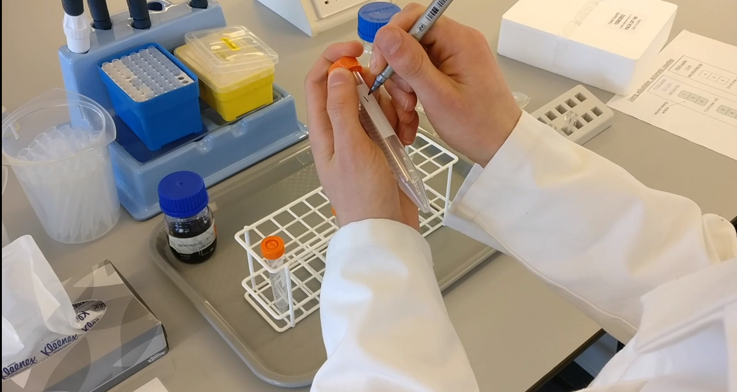

Slide 11
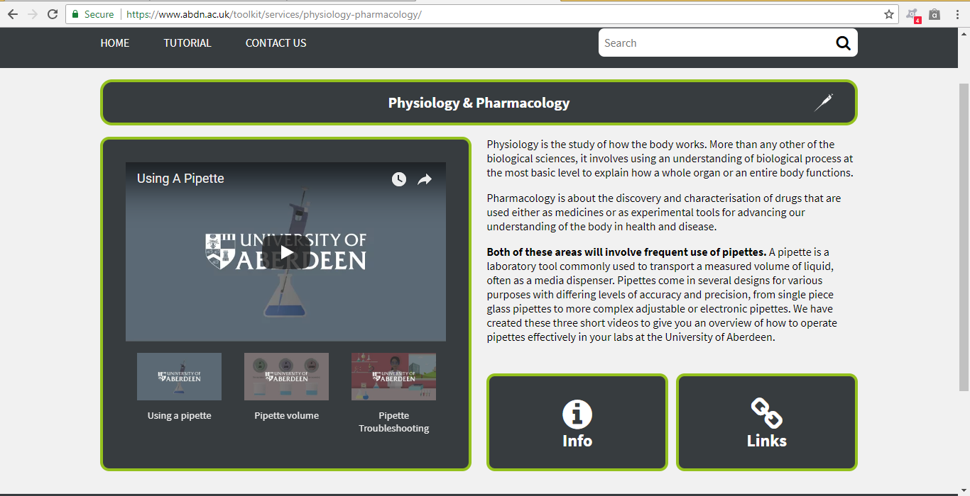

Slide 12
Enhancements – since last year
Remove paper and automate (iPad marking)
Increase the number of staff (engagement) and disciplines.
Remove subjectivity in assessment.
Increased student numbers
Emergency back up plans (business continuity)
Duplicate stations and multiple locations used
Videos of stations on VLE to help practice and preparation
Integrate use of technology
Encourage greater student reflection on skills weaknesses (time management, communication etc)
Different stations?
Outreach, remote and rural considerations?

Slide 13
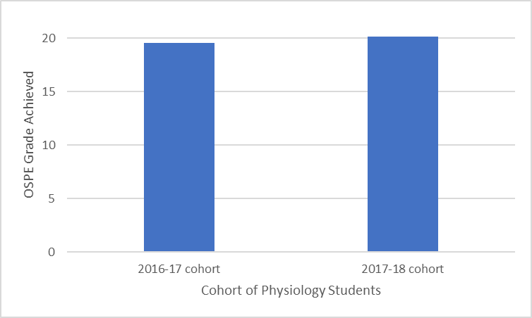
What happened when we reduced practice time and used videos?
No significant difference in mean score achieved by physiology students (2017-18 cohort, 20.11 ± 2.00, n = 43) was identified when comparing with data recorded last year from students who did not have access to the video resources (2016-17 cohort, 19.54 ± 1.26, n = 52) ( Data represents mean score ± stdev).
Suggests that student performance did not suffer by reducing the practice time before the assessment.
The same result was observed in a separate anatomy cohort.

Slide 14
How confident were you BEFORE the OSPE about your ability to complete the stations properly?
1 – not confident at all
5 – extremely confident
N=53

Slide 15
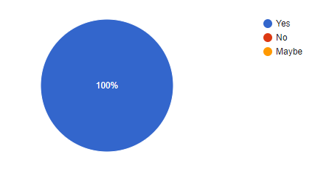
Did you prefer the OSPE to a 'traditional' practical?
N = 53

Slide 16
How much did you use the videos to prepare for the OSPE?
1 = not at all
5 = a huge amount
N = 53

Slide 17
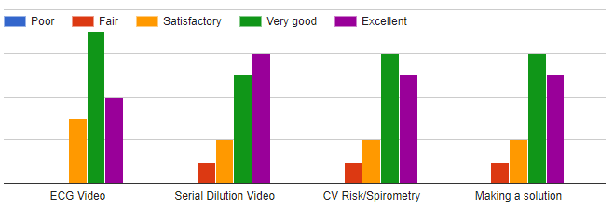
How effective did you think each video was in terms of helping you learn what was expected at each station?

Slide 18
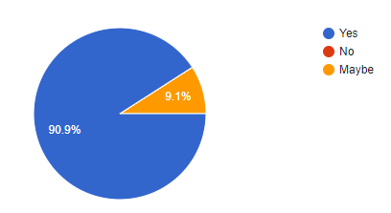
Did the OSPE make you think about skills other than practical scientific ones that employers/ project supervisors might expect you to possess?
N = 53

Slide 19
Comments about videos
Some small errors
Large file size, takes time to buffer – maybe use Youtube so we can access via phones?
Liked that none of them long – usually 3-5 minutes
Liked that it was students designing and presenting them – at correct level
Should make more for all sorts of skills types during our curricula
Staff felt they spent less time explaining how to do things but more time discussing why things mattered and reflecting with students about their approaches

Slide 20
Outcomes & Feedback
Students
Found the process “a bit stressful” but worthwhile preparation for upcoming practical work and employment opportunities.
Reported thinking more about skills expected in future employment, and also considering their strengths and weaknesses.
Appreciated videos, but can always improve
Staff
A useful way of assessing wide array of graduate attributes at Honours level WITHOUT large amounts of paperwork.
However, requires planning, clear aims and flexibility in initial stages.
Assessment of communications skills improved
Reduced staff workload without apparently causing any detrimental effects to student experience and performance

Slide 21
Future plans
Interest from other disciplines such as philosophy and chemistry
Views of employers as to what skills they feel should be incorporated
Similar views sought from students
Improving videos based on feedback
Addition of gamification resources e.g. Quizlet to help students prepare

Slide 22
Thank you

