Slide 1
Student Representation and Feedback
Enhancing the Student Voice

Slide 2
University of Edinburgh Structure
3 Colleges
21 Schools
200+ Programmes
39,500 Students

Slide 3
Representation Structures
5 Sabbatical Officers, 4 Liberation Officers, 7 Section Reps
2 University-wide Postgraduate Reps
44 School Representatives
2800+ Class Representatives (tutorial, course, programme)

Slide 4
Programme Representatives
Course/Class Reps
Programme Reps
Fewer representatives, more empowerment
Appointments/elections
More inclusive of students on joint-degree programmes (14% at Edinburgh)
Allows for a wider dialogue regarding the whole student experience
Strengthens the relationship between the the Programme and School reps
Develop in-person, school specific training

Slide 5
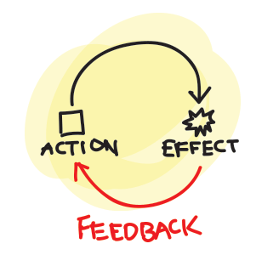
Closing the Feedback Loop
Developed training; how to collect representative feedback and how to relay the results back to the students
Clear communication channels and responsibility
Utilising the VLE as a Representation Hub

Slide 6
Mid-course feedback
Collected by the course organiser at the midpoint of a course
Purpose of making improvements to the current cohort
Facilitated through questions, postcards or electronically via Tophat
Feedback can be given verbally, in a recording or online

Slide 7
Student Voice
Course
Mid-course feedback
Course Evaluation Questionnaires
Programme
Student-staff Liaison Committees
School/University
PATH
School Committees
NSS/PRES/PTES

