Slide 1


A Scotland wide approach to student mental health
Katie Gilbert
Think Positive Project Manager

Slide 2

Student Mental Health Agreement (SMHA) project overview
Examples of SMHA’s that universities and students’ associations are taking forward
The Think Positive Hub

Slide 3


SMHA Overview

Slide 4

Student Mental Health Agreements
77% of all colleges and universities in Scotland participate in creating their Student Mental Health Agreements in joint partnership with their students’ associations.
The SMHA outlines how the whole institution will approach their student mental health and wellbeing work over a two-year period.
The content of each individual SMHA varies, however they all follow the same development steps including collaborating directly with students to shape the work.

Slide 5

Student Mental Health Agreements
It’s the only project of its kind which specifically focuses on improving student mental health and wellbeing in the FE and HE sector in Scotland.
Participants benefit from a variety of support including 121 consultancy throughout the year, sector specific events and the support of a network of people focusing on mental health in FE & HE across Scotland.

Slide 6

What do all SMHA’s have in common?
They all follow the same steps process when being developed and monitored.
The institution works in partnership with the students’ association to develop, monitor and evaluate this work together. They decide on the content and use student feedback to inform and shape the work.
Each SMHA has working areas with a list of actions to be taken.
SMHA’s have success measures built in to help project participants to monitor the work and highlight when progress has been made.
They are backed up by internal statistics/feedback specific to the institution, as well as national research.

Slide 7
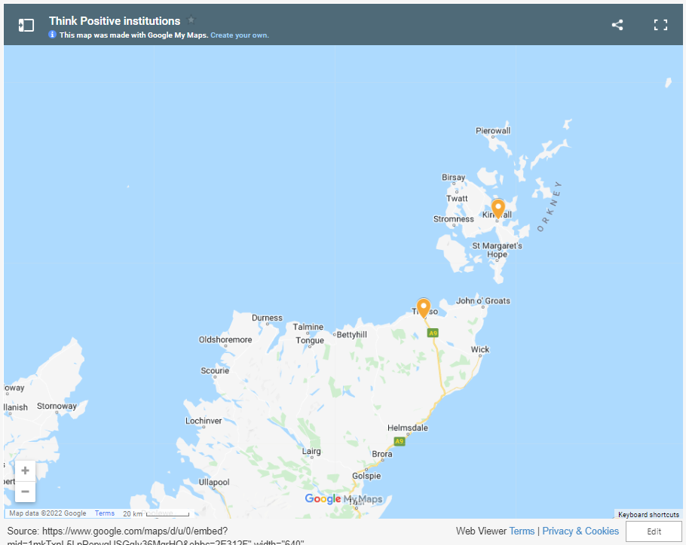
Title

Slide 8
Project participants
2022

Slide 9
Project participants
2022

Slide 10



Slide 11


Slide 12


The Think Positive Hub

Slide 13
Think Positive Hub walkthrough
www.thinkpositive.scot

Slide 14
Thanks for listening!
Katie.gilbert@nus-scotland.org.uk
www.thinkpositive.scot

