Slide 1
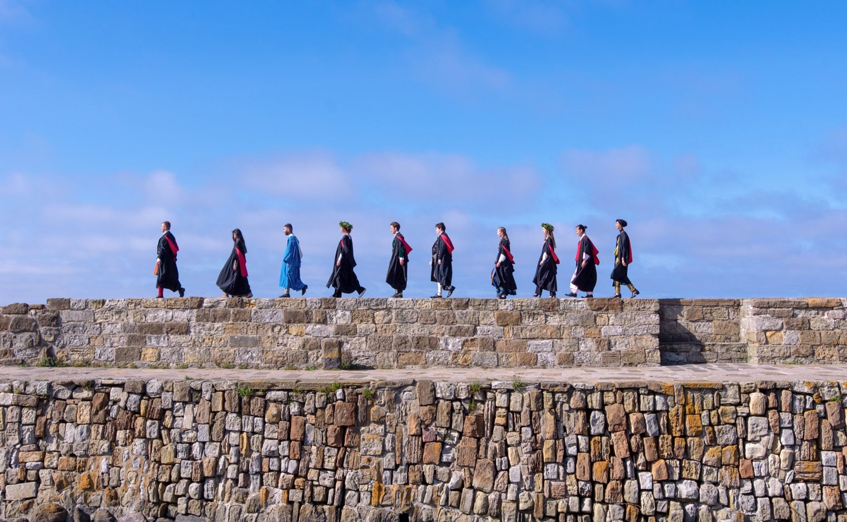
Sanctuary St Andrews: Journey to becoming a University of Sanctuary and supporting the growth of a diverse community

Slide 2
Becoming a University of Sanctuary
Diversity and inclusion should be at the heart of the St Andrews experience, and should inform all that we do. As a truly international and world-class university, our ambition is to be a beacon of inclusivity.
A national network of university staff, lecturers, academics and students, working to make Higher Education institutions places of safety, solidarity and empowerment for people seeking sanctuary.
Cara provides urgently-needed help to academics in immediate danger, those forced into exile, and many who choose to work on in their home countries despite serious risks. Cara also supports higher education institutions whose work is at risk or compromised.

Slide 3
Becoming a University of Sanctuary
December 2018 | St Andrews Refugee and Forced Migration Network established
March 2019 | Academic Council endorses a proposal to apply to become a University of Sanctuary
March 2019 | Application submitted by the St Andrews lead, Prof. Rebecca Sweetman
Summer 2019 | Feedback and improvement process
August 2019 | University awarded Sanctuary status
November 2019 | Sanctuary Operations Group formed
March 2020 | Celebratory event in St Andrews
September 2020 | Welcomed first cohort of Sanctuary Scholars
March 2022 | Sanctuary Celebration Week held

Slide 4
Becoming a University of Sanctuary
Fee status
St Andrews reclassified students seeking asylum as ‘Home’ (Scotland) students for tuition fee purposes
Refuge, humanitarian protection, limited leave to remain and discretionary leave to remain already classified as ‘Home’ (Scotland) or ‘RUK’ in Scotland
Identifying key colleagues and stakeholders
Identified key colleagues/departments to support Sanctuary initiatives: Global, Admissions, Access and Widening Participation, Registry, Development, Careers, Library, Community Engagement, Student Services and Academic Schools
Engaged with student groups and external organisations
Discussions about the initiative were held with senior leadership as early as possible
Promotion
Communicated University of Sanctuary status internally to staff and students
Presentations held during Academic School meetings

Slide 5
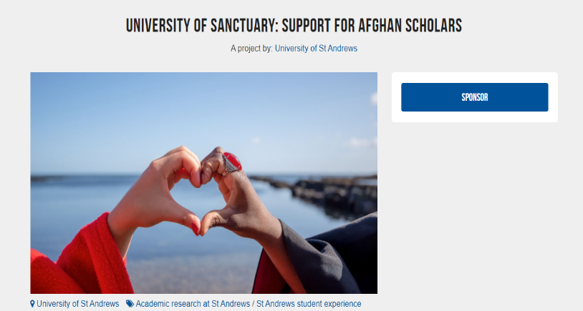
Becoming a University of Sanctuary
Sustaining the expansion of Sanctuary activities
Reporting on Sanctuary initiatives and gathering testimonials where possible
Expanding funding opportunities and partnering with foundations and trusts
Launching crowdfunding campaigns in response to world crises

Slide 6
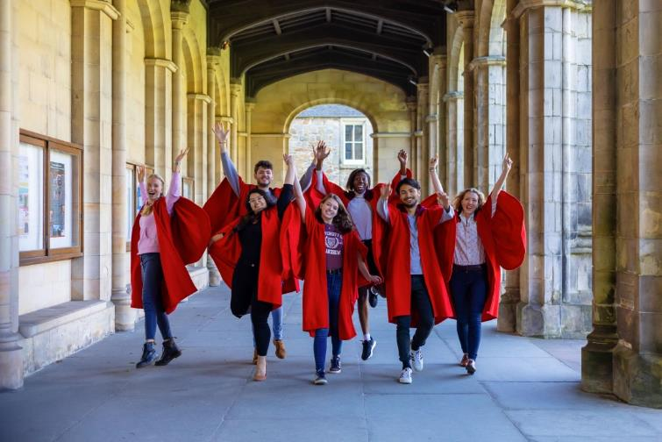
St Andrews Sanctuary Scholarships
Sanctuary Scholarships support maintenance and tuition
UG Sanctuary Scholarships (2 4)
Up to £7,500 maintenance per year plus tuition fees
PGT Sanctuary Scholarships (4)
Flexible funding of up to £22,000
PGR Sanctuary Scholarships (2 4)
Flexible funding of up to £15,000
Open to any applicant that has one of the following official Home Office statuses:
Asylum Seeker
Refugee
Humanitarian protection
Limited leave to remain
Discretionary leave to remain

Slide 7
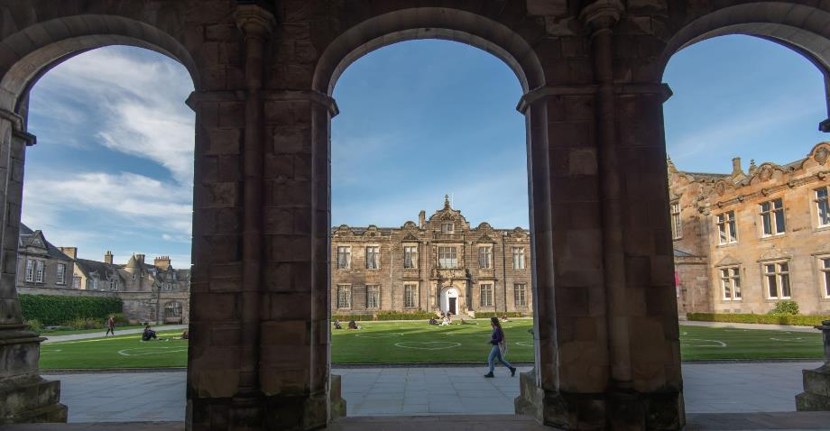
Central support for Sanctuary Scholars
Global Office acts as the central point of contact for Sanctuary Scholars
Induction and welcome session held before the start of semester
Weekly Sanctuary consultation hours during the academic year
Invited to information sessions and welcome events for international cohorts
Student internship focused on enhancing our induction and resources for Sanctuary Scholars

Slide 8
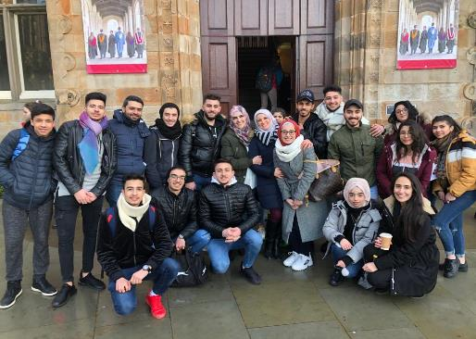
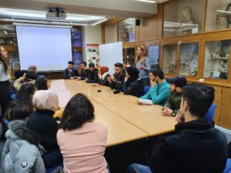
Outreach and promotion
Clear and accessible webpage(s) dedicated to Sanctuary Scholarships and University of Sanctuary
Utilised social media and existing networks, including STAR, to promote scholarships
Identified outreach opportunities:
As part of the Syrian Futures programme, St Andrews welcomed 17 Syrian young people in February to tour the University and attend taster sessions
Discussions with Fife Council to support applicants from Afghanistan

Slide 9
Sanctuary Celebration Week 2022
Tuesday 8 March 2022 | St Andrews Sanctuary Lecture: What does 'Sanctuary' mean?
Wednesday 9 March 2022 | City of Sanctuary consultation session University of Sanctuary information session
Thursday 10 March 2022 | Sanctuary Research Afternoon: Addressing the Impact of Forced Displacement
Friday 11 March 2022 | Cultural and Religious Identity During the Syrian Uprising seminar Moving Art, Connecting Voices

Slide 10
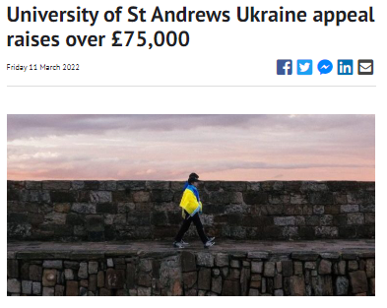
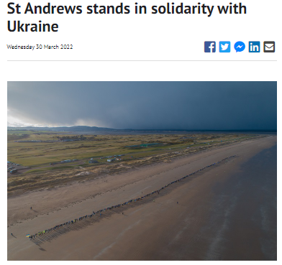
Responding to global crises

Slide 11
Harriet Sheridan
Partnerships Officer, Global Office
E: sanctuary@st-andrews.ac.uk
https://www.st-andrews.ac.uk/study-abroad/sanctuary/

