Slide 1
Evaluation made much easier?
Dr Liz Austen - Head of Evaluation & Research, Sheffield Hallam University & Visiting Professor, Staffordshire University
Professor Stella Jones-Devitt - Professor of Critical Pedagogy, Staffordshire University & Visiting Professor, Leeds Beckett University
Photo by Josh Duke on Unsplash

Slide 2
Overview
This interactive session introduces participants to the Universal Evaluation Framework (UEF) developed in conjunction with work undertaken by the session facilitators when evaluating the 20 Years plus of QAA Scotland Enhancement Themes.
The framework is proposed as an evidence-informed game changing tool to support colleagues undertaking evaluation activities.
The UEF can be used regardless of levels of evaluation experience and starting point. Participants will be able to play with UEF and we will be focusing upon the Theory of Change component especially.
By the end of the session, participants should be able to:
Feel more confident in understanding key questions they need to address when embarking on evaluation at all levels
Examine how to capture appropriate evidence to meet addressing those questions successfully.

Slide 3
Our QAA Scotland Evaluation Odyssey
What have we done so far, and what are we planning
Undertaken historical documentary analyses
Produced a Gap Map to show areas for further exploration
Created lines of enquiry (LoE) to examine the gaps
Began holding relevant LoE conversations
Facilitated lots of capacity & confidence-building activities
Produced a Universal Evaluation Framework prototype

Slide 4
The Universal Evaluation Framework (UEF)

Slide 5
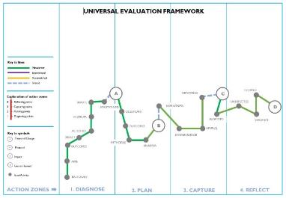
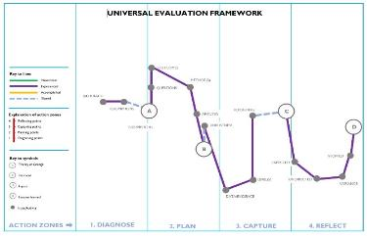
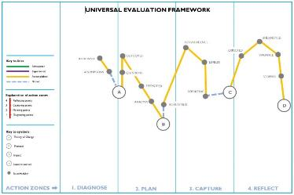
Making UEF work….

Slide 6
Exploring UEF Issue/Activity Point A
A
Q: What is a Theory of Change?
A Theory of Change (ToC) is “essentially a comprehensive description and illustration of how and why a desired change is expected to happen in a particular context. It is focused, in particular, on mapping out or “filling in” what has been described as the “missing middle” between what a program or change initiative does (its activities or interventions) and how these lead to desired goals being achieved. (The Centre for Theory of Change, 2021).
Q: How are we using a ToC in our evaluation of the QAAS Enhancement Themes?
Co-constructed ToC with key stakeholders in the Resilient Learning Communities Theme
Contribution analysis of impact of the 20 years of the Enhancement Themes aligned to the co-constructed ToC

Slide 7
Key Elements of a Theory of Change
Nathaniel Pickering 2022
Situation
Aims/Goals
Rationale
Inputs
Activities
Outputs
Outcomes (short, medium, long)
Evidence: Barriers
Evidence: What Works
Assumptions

Slide 8
Understanding Theory of Change... Piece of Cake!
Nathaniel Pickering 2021
Logical Model
Planning and preparing ingredients, and recipe...
Victoria Sponge cake
Inputs
...mixing, baking...
Activities
...delicious cake..
Outputs
...people who eat the cake are full and happy
Outcomes

Slide 9
Group activity
Instructions:
Familiarise yourselves with the hexagons and scenario on your table (or online handout) which are parts of a Theory of Change for the given example.
Map a logical connection from outcomes to activity, considering the associated inputs and outputs.
Use the blank hexagons to add any important omissions or space for unintended consequences
Discuss the assumptions, evidence, barriers and enablers underpinning your decisions.
Discuss how this approach would be useful for your own work

Slide 10
Group Activity Scenario
You are a course team at the University of Magic Enterprise, and you begin looking at your student outcomes data and student profiles. In a Staff-Student Committee meeting, it is raised by a student rep that there is a lack of interaction and social engagement on the course. You have read around the subject matter of belonging and mattering, learning communities and student engagement. Collaboratively, you then begin to think about how this situation can be changed.
Supporting evidence: Austen, L., Hodgson, R., Heaton, C., Pickering, N., & Dickinson, J. (2021). Access, retention, attainment, progression – an integrative literature review. AdvanceHE. https://www.advance-he.ac.uk/news-and-views/access-retention-attainment-progression-integrative-literature-review
Photo by Dollar Gill on Unsplash

Slide 11
Designing a Peer Mentoring Programme: Play then discuss!
Participating students report an increased sense of belonging
Scheduled mentoring sessions during the academic year
A ‘How to’ Online Toolkit for practitioners
£500 budget for payment of mentors
Recruitment and training of students
Participating students feel motivated to engage with their course
50 students participate in the programme
Participating students are less likely to withdraw from their course
½ day per week of staff time for admin
Mentors and Mentees develop the skills and knowledge to support their peers
Participating students achieve better levels of attainment

Slide 12
Understanding Theory of Change... Piece of Cake!
Nathaniel Pickering 2021
Logical Model
Planning and preparing ingredients, and recipe...
Programme: Peer Mentoring
Victoria Sponge cake
Planning and preparing: money, staff, resources...
Inputs
...mixing, baking...
...delivering peer-mentoring programme...
Activities
...delicious cake..
...mentees attend, and engage and mentors support their peers...
Outputs
...people who eat the cake are full and happy
...motivated, valued, successful graduates..
Outcomes

Slide 13
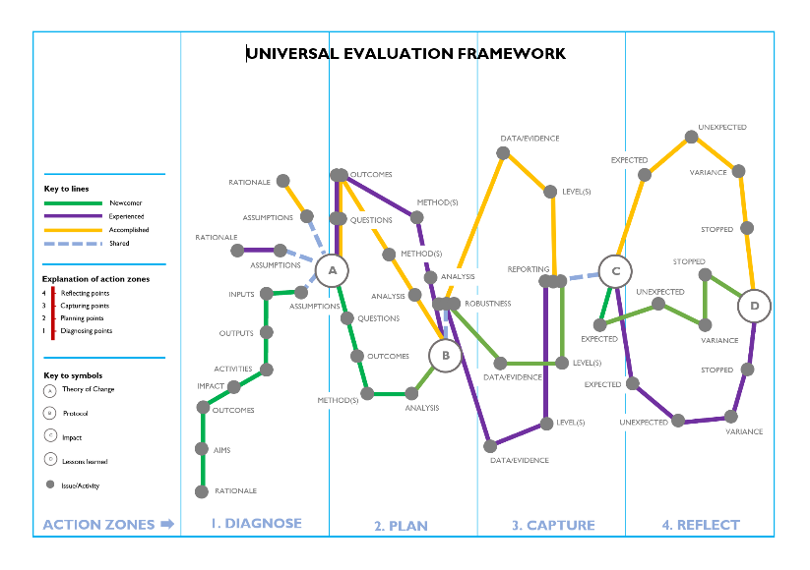
Where would the UEF take you next on your evaluation journey?
A ToC is not your evaluation! You will need an accompanying evaluation plan which aligns evidence collection to measures/indicators for each outcome.
The next issues/activity point on the UEF would be......

Slide 14
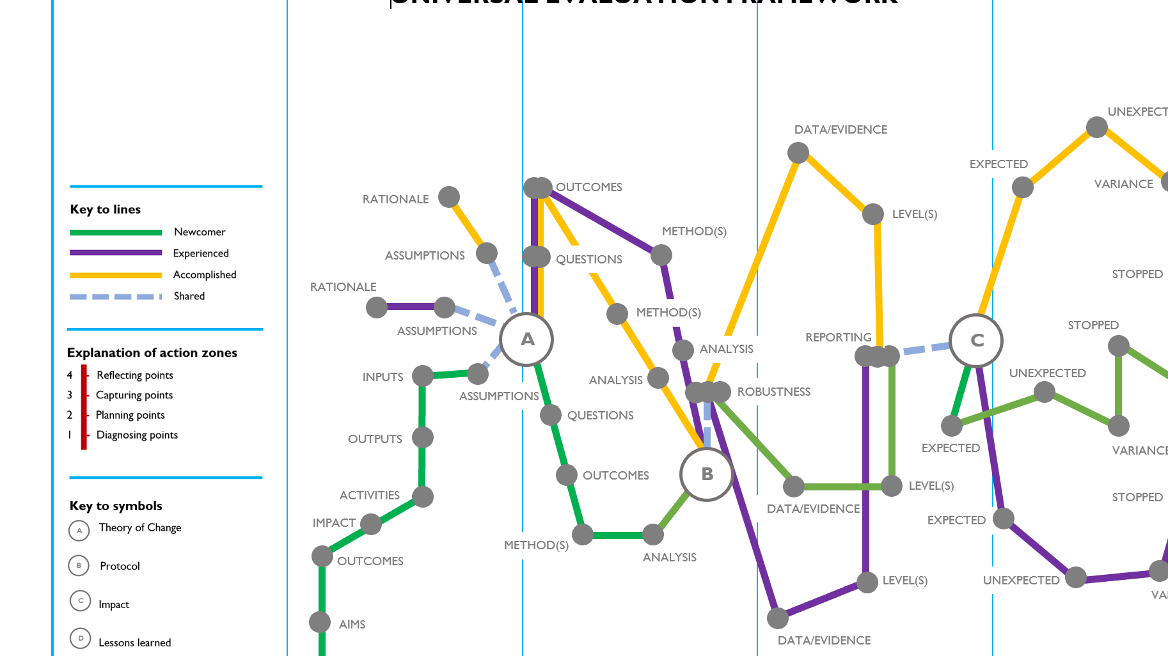
How can you get involved with further development of the UEF?
Let us know directly that you would like to ‘play’ by emailing us at:
scolpp@staffs.ac.uk
OR
Stay in touch via the QAAS Evaluation of Enhancement Themes pages for further opportunities to engage & some great resources
OR
Tweet us @jonesdevitt & @lizaustenbooth
Thank you!

