Slide 1
Supporting student reps to engage with issues of equity
Student-Led Project Steering Group Enhancement Themes Conference Wednesday 8th June 2022

Slide 2
Student-Led Project (SLP)
Partnership working between QAA Scotland and sparqs.
Activity led by a Steering Group – chaired by the Enhancement Themes Student Lead.
Each year, the SLP chooses a new topic to focus on under the wider Enhancement Theme.

Slide 3
Student-Led Project Steering Group 2021-22
Damilola Adesanya, President Education & Welfare, RGU Students’ Union
Calum Brown, VP Education, University of Stirling Students’ Union
Mia Clarke, VP Education, Glasgow University Students’ Representative Council
Heather Innes, VP Higher Education, Highlands & Islands Students’ Association
Ondrej Kucerak, VP Education, Aberdeen University Students’ Association
Zechariah Laari, VP Academia, Dundee University Students’ Association
Amy McLuckie, Co-President, SRUCSA
Kevin Miguim, VP Education SAUWS
Viki Soper, Access Participation and Success Officer, OU in Scotland
Supported by sparqs (Patrycja Mitrut and Megan Brown) and QAA Scotland (Demelza Curnow and Caroline Turnbull).

Slide 4
This year’s theme: Promoting the Equity of the Student Learning Experience
HEIs in Scotland are currently reflecting on learning from the pandemic, in order to continue to develop approaches that maximise the benefits of a more blended environment.
Universities and students’ associations are working collaboratively to build a student experience that supports all students however and wherever they learn and to support the diverse needs of their student populations.
This year’s project will consider how students and staff can support equity for diverse student communities to allow students to get maximum benefit from their learning opportunities.

Slide 5
Outcomes of the project:
1
2
3
Identifying and raising awareness of the barriers to students in accessing equity of learning and teaching and how these can be mitigated against.
Promoting examples of good practice in equitable learning and teaching practices.
Preparing and equipping class reps to raise equity issues where they arise, effectively represent all students and better undertake their roles in representative structures.

Slide 6
Today’s session:
This workshop will explore with attendees the roles institutions and students’ associations can have in supporting student reps and rep systems to effectively engage with issues of equity.
How can we create and support student rep systems that effectively capture the views of our diverse student population?
What opportunities are there to engage with issues of equity throughout the whole of the rep journey?
What can we learn from existing practice where students and students’ associations have supported reps to engage with issues of equity, or made more equitable rep systems?

Slide 7
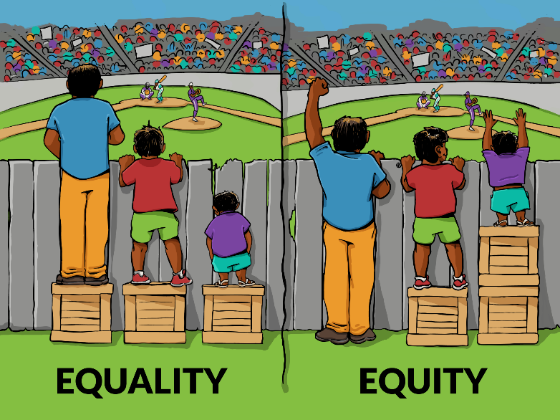
Equality vs Equity

Slide 8
Workshop Activity:
In your groups, you will consider the journey of a student rep.
What barriers and opportunities are there to engagement at each stage?
An opportunity to share good practice and challenges.
You’ll have 30 minutes to answer a set of questions on equity in a stage of the rep journey:
Recruitment
Training and resources
Rep processes, systems and structures
We’ll then take 15 minutes to feed back as a group.

Slide 9
Our reflections
Where possible, provide choice for reps to engage in their role e.g. different times of the day and locations of training, different formats, alternative ways to contribute to a student-staff liason committee.
Consider how to provide online spaces for your reps e.g. a Microsoft Teams space, that allows reps to engage with one another as easily as possible.
Reps should be trained and supported to understand the diversity of the students they represent.
Protected characteristics.
Other groups such as articulating students, student parents and carers, students whose first language is not English, students studying in a rural location.

Slide 10
Our reflections
Equip reps with the knowledge to signpost to specialist services (while reassuring them they do not need to be specialists themselves).
If your students’ association has liberation officer roles (or equivalent), ensure that your reps know about them and how to contact them.
Engage with your existing reps on equity initiatives - work in partnership with reps to identify issues and solutions.
Capture who your reps are through diversity monitoring - you can’t manage what you don’t measure.

Slide 11
sparqs’ Monitoring the Diversity of Course Reps Project
The project began in 2017 with a pilot study of four institutions, using a questionnaire administered to course reps during their training.
Covers 14 demographic areas.
This year (2021-22), the project received responses from over 3,000 reps in 23 institutions.
Participating institutions receive an institutional report for internal use.
Data collected is also aggregated into a national dataset.
If you would like to find out more, contact Patrycja.Mitrut@sparqs.ac.uk.

Slide 12
Thank you - any questions?
A call will open shortly for new members of the Student-Led Project Steering Group for 2022-23.
To see all the outputs we’ve created as part of the SLP, see our page on the Enhancement Themes website.
To hear more about our other SLP outputs from this year, come to our session tomorrow at 11.20!
For more information, contact Megan.Brown@sparqs.ac.uk.

