Slide 1
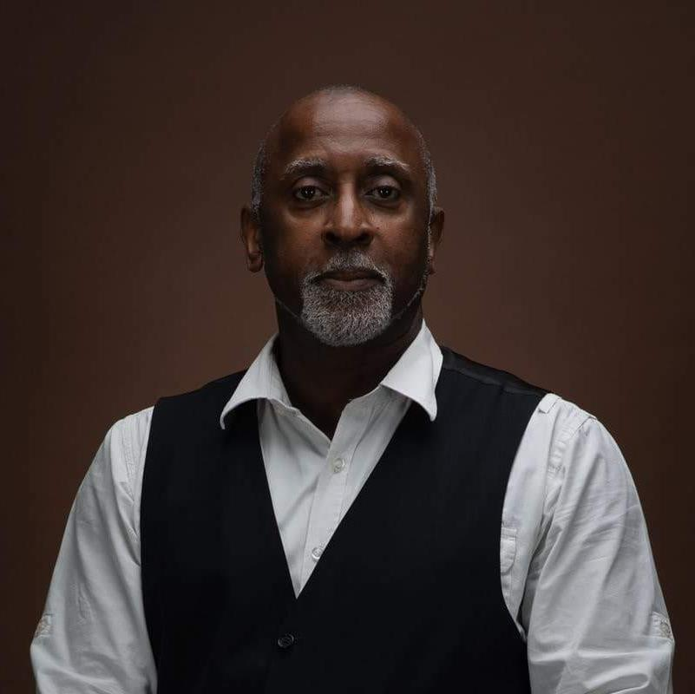
Reflections on resilience and moving forward
Delroy Hall, PhD, M.A. Dip Coun, Cert. Ed.
Enhancement Conference: Resilient Learning Communities – Inclusive, Flexible and Accessible
Delwes Consultancy Ltd
9 June 2022
www.delwes.com

Slide 4
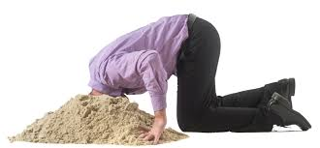
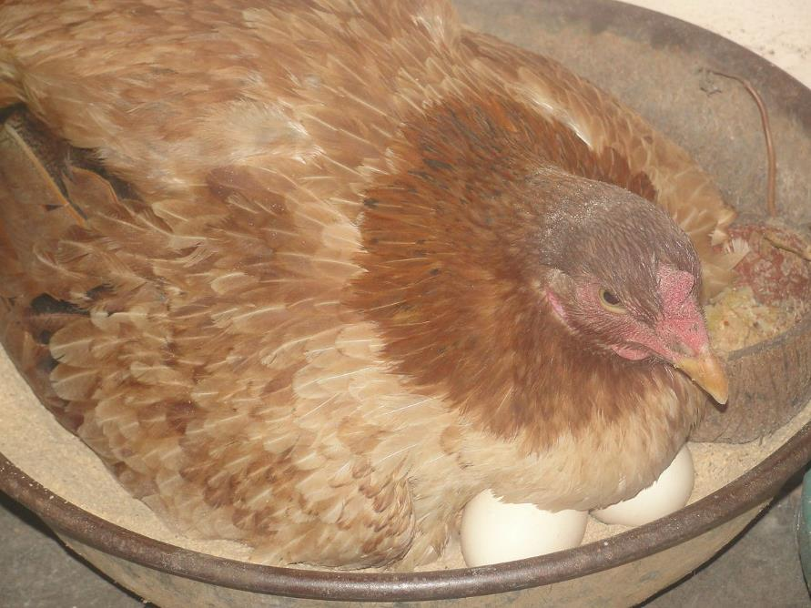

Slide 5
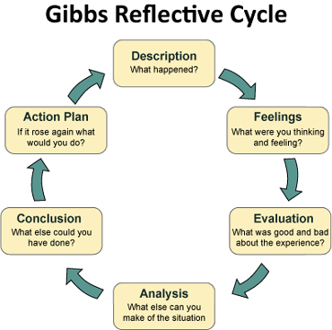

Slide 8
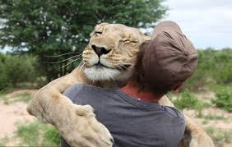
Thank You!!!!!!!

Slide 9
Contact Details
Tel 07828500726
delroy@delwes.com
www.delwes.com
@DelroyDr

