Slide 1
Successful Flexible, Accessible Pathways: Making this Work
Professor Ruth Whittaker
PVC Education and Students University of Brighton
Chair of National RPL Framework for Scotland Expert Group
R.Whittaker2@brighton.ac.uk

Slide 2
What are we trying to achieve ?
Widening Participation
Lifelong Learning
Workforce development
Economic Growth
Progression pathways
Upskilling,
Reskilling
Social inclusion
Flexible delivery
Transformation?

Slide 3
UK Policy context
Scotland
SFC Review of Coherent Provision and Sustainability
England
Skills Bill; Post Augar HE Reform- Lifelong Loan Entitlement
Wales
Tertiary Education and Research (Wales) Bill
NI
Skills for a 10x Economy

Slide 4
Collaborative tertiary eco-system
Skilled workforce
Regional focus
Priority areas
Economic Growth

Slide 5
How can we make flexible, accessible pathways work?
Supply
Demand

Slide 6
How can we make flexible, accessible pathways work?
Learner
Clear progression pathways
Recognition of prior Learning
Information, advice and guidance
Transition support

Slide 7
How can we make flexible, accessible pathways work?
The role of Recognition of Prior Learning (RPL) today?

Slide 8
What does RPL mean?
Process for recognising learning that has its source in experience and/or previous formal, non-formal and informal learning contexts:
knowledge and skills gained within school, college and university
outside formal learning situations such as through life and work experiences.
RPL recognises the value of learning wherever it occurs, either to meet programme entry requirements or to achieve credit towards a named award and/or support educational or career planning

Slide 9
The role of RPL today?
Skills agenda and economic growth
Meeting employer needs
Supporting growing diversity of learning and qualifications landscape:
Apprenticeships
Higher vocational /technical qualifications
Modular and microcredentials
Widening participation

Slide 10
RPL today : a global perspective
Recognition of Prior Learning : an International Scan
QAAS, August 2021
Differing terminology, processes, frameworks and support for RPL across the globe
https://www.enhancementthemes.ac.uk/docs/ethemes/resilient-learning-communities/recognition-of-prior-learning-an-international-scan.pdf?sfvrsn=4267d681_14

Slide 11
Recognition of Prior Learning National Framework for Scottish HE Review
Why and How?
RPL Expert Review Panel
QAAS consultation work in 2021- international scan
Flexible and Accessible Learning strand of the Enhancement Theme ‘Resilient Learning Communities’: Recognition of Prior Learning and Experience (RPL/RPEL) and the use of Micro credentials
Current practice in the Scottish HEI sector; QAA and SCQF RPL toolkits; surveys

Slide 12
Four Key Sections
The 4 sections will remain but the PSRB level section will be updated to:
Employers and Professional Bodies

Slide 13
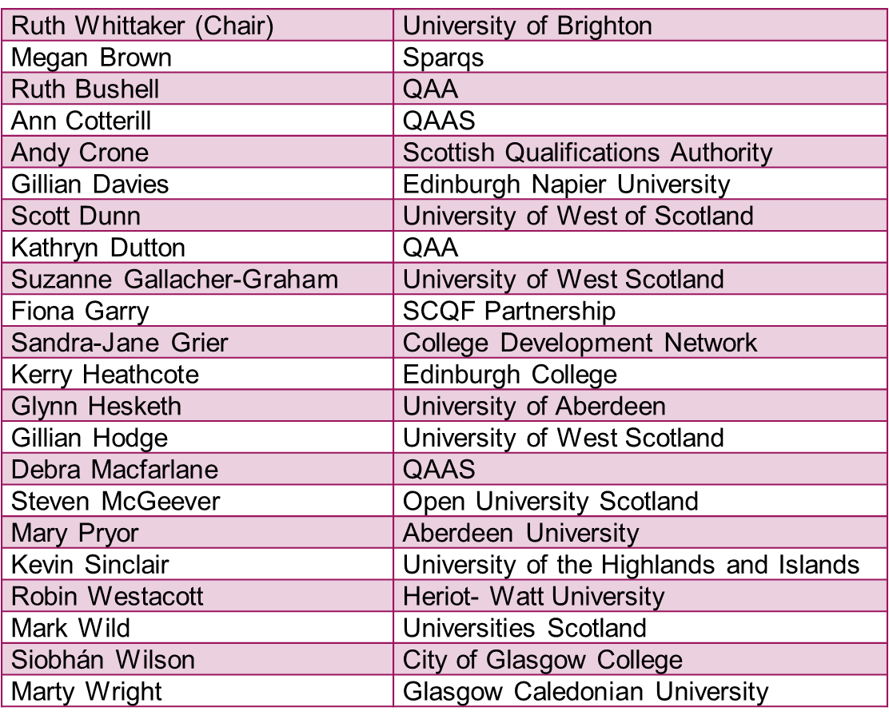
RPL Expert Group

Slide 14
The Writers
Section | Lead(s) | Contributors
Foreword and Introduction/Purpose | Ruth Whittaker, Ruth Burchell & Ann Cotterill | Expert Review Group
Student Level | Suzanne Gallacher & Gillian Hodge | Megan Brown
Sector Level | Kevin Sinclair | Siobhan Wilson Kerry Heathcote
Institution Level | Gillian Davies | Steven McGeever Kevin Sinclair
Employers and Professional Bodies | Marty Wright | Robin Westacott Andy Crone Fiona Garry

Slide 15
Recognition of Prior Learning Framework for Scottish HE: next steps
Publication Summer 2022
2022/23
Tertiary Sector RPL Community of Practice
Publish a range of Models of Practice, including case studies

Slide 16
Border Crossing
Supporting non-linear pathways
Valuing learning –the role of credit
A more flexible, accessible HE system
What do we need to make this work?

Slide 17
Border Crossing – key enablers
Information advice and guidance
Tertiary skills eco system
Framing learning – the role of learning outcomes
Assessing informal/non formal learning
Admissions processes
Supporting transition
Flexible delivery models
Funding model

Slide 18
Transforming practices

