Slide 1
Creativity, collaboration & confident change Towards a practical manifesto for programme leadership
QAA Enhancement Themes Conference 2022
Julie Blackwell-Young, Martha Caddell, Kimberly Davis, Christine Haddow

Slide 2
Programme Leadership, Collegiality & Sustainable Resilience
Programme teams as significant feature in university landscape.
Programme Leaders as ‘invisible superheroes of learning and teaching”
(Cunningham & Wilder 2019)
(Post) pandemic lens: Focus on resilience, wellbeing and support.
What does this current moment of insight mean for our teaching teams and the support we offer those who lead them?
Beyond individual ‘bounce-backability’ to exploring the “collective responsibility of a collaborative team” (Hack 2020).
Wider institutional and sector responsibilities in supporting key educational leadership roles.

Slide 3
QAAS Collaborative Cluster: Key Activities
Advancing Understanding of Programme Leadership
Webinars combining Keynote discussion and sharing practice.
Connecting Programme Leaders, Changing Practice
Multi-institution Action Learning Sets.
Thinkpieces and case studies.
Reconceptualising programme leadership, offering practical advocacy and guide for action.

Slide 4
QAAS Collaborative Cluster Programme Leadership Resources
https://www.enhancementthemes.ac.uk/evidence-for-enhancement/optimising-existing-evidence/enhancing-programme-leadership
https://www.enhancementthemes.ac.uk/resilient-learning-communities/completed-projects/programme-leadership-strengthening-resilience-supporting-learning-communities

Slide 5
A Practical Manifesto for Programme Leadership
Join us in a call to practical action!
Champion programme leadership.
Enhance visibility and amplify voices.
Identify practical steps that will really make a difference.
Share examples of practice – and aspirations and ambitions.

Slide 6
Preparing the Manifesto: Inspiration and Provocation

Slide 7
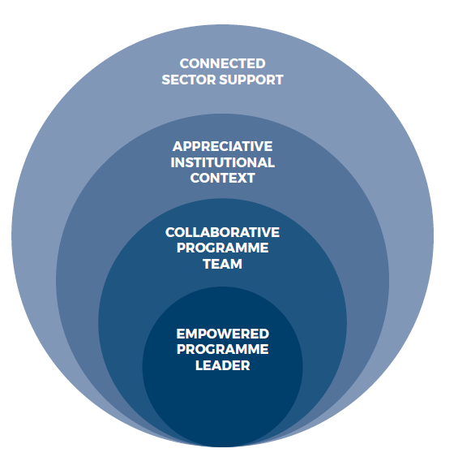
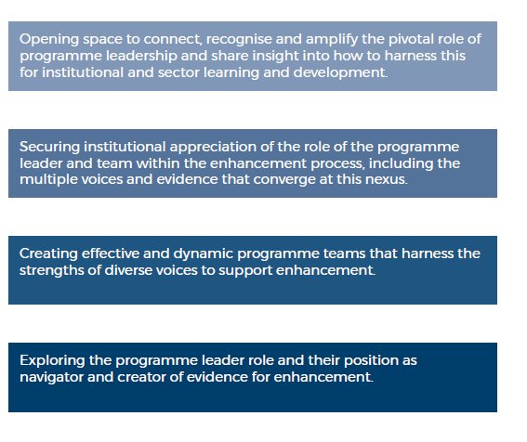
Programme Leadership in Context Spheres of influence and action

Slide 8
Collective Action & Ambition
Accelerate support across all ‘Spheres’:
Heightened need for visibility & action. Support for PL role and appreciation of wider team-working.
Space for development & peer-support, recognising time & work pressures
Recognition and reward for PLs within institutions.
Scholarship, sector visibility & drive for change.

Slide 10
Snapshots of Practice
Institutional action to support programme leadership.

Slide 11
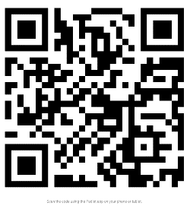
A Practical Manifesto for Programme Leadership
Join us in a call to practical action!
A rallying call
Practical calls to action and priority pledges.
Examples of impact … and ambition.

Slide 12
A Practical Manifesto for Programme Leadership
Reflections and Discussion

Slide 13
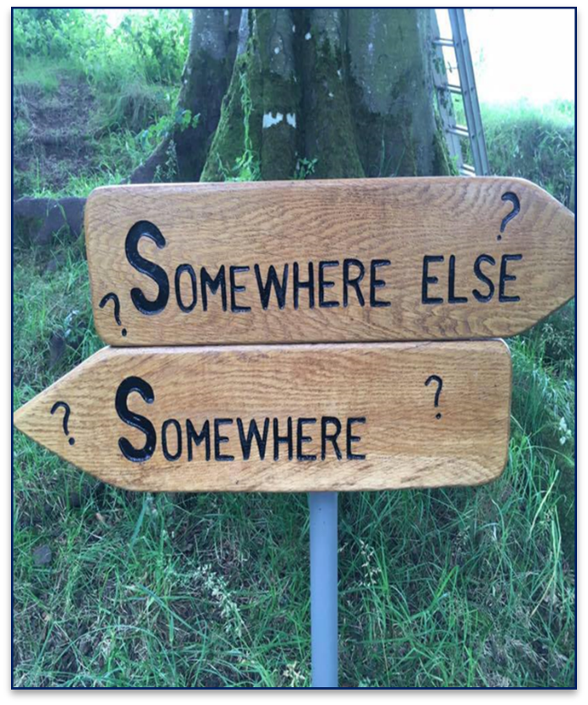
Conclusion and Next Steps
Creating a culture of enhancement that truly empowers programme leadership within institutions and across the sector.
Consolidate and share the Programme Leadership Manifesto.
Continue sector conversation and practical action.
Develop and share scholarship and practical research across the sector.
Continue the Conversation: M.Caddell@hw.ac.uk

Slide 14
Thank-you

Slide 15
Useful Resources
Blackmore, P. and Kandiko, C. B. (2011). Motivation in academic life: a prestige economy. Research in Post-Compulsory Education 16(4), 399-411.
Brink, C. (2018). The soul of a university: Why excellence is not enough. Bristol: Bristol University Press.
Caddell, M. & Haddow, C. (2019) Creating Cultures of Enhancement, Supporting Programme Leadership. Webinar and Quick Start Resource presented to QAA Scotland as part of Enhancement Themes Series. November 2019. https://www.enhancementthemes.ac.uk/docs/ethemes/evidence-for-enhancement/programme-leadership-in-focus-quick-start-card.docx?sfvrsn=f705c881_4
Caddell, M. & Wilder, K. (2018) ‘Seeking Compassion in the Measured University: Generosity, Collegiality and Competition in Academic Practice’, Journal of Perspectives in Applied Academic Practice. 6(3).
Cahill, J. Bowyer, J. Rendell, C., Hammond, A. and Korek, S. (2015). An exploration of how programme leaders in higher education can be prepared and supported to discharge their roles and responsibilities effectively. Educational Research, 57 (3), 272-286.
Cunningham, C. and Wilder, K. (2019). Programme Leaders as Invisible Superheroes of Learning and Teaching. Enhancing Programme Leadership: Project Outcomes. Available online at: https://www.enhancementthemes.ac.uk/docs/ethemes/evidence-for-enhancement/programme-leaders-as-invisible-superheroes-of-learning-and-teaching.pdf?sfvrsn=e862c381_8
Ellis, S. (2019). Programme Leadership: A Review of Evidence and an Agenda for Action. Enhancing Programme Leadership: Project Outcomes. Available online at: https://www.enhancementthemes.ac.uk/docs/ethemes/evidence-for-enhancement/programme-leadership---a-review-of-evidence.pdf?sfvrsn=97f4c381_6
Ellis, S. and Nimmo, A. (2018). Opening eyes and changing mind-sets: professional development for programme leaders. In Lawrence, J. and Ellis, S. (Eds), Supporting Programme Leaders and Programme Leadership (London: Staff and Educational Development Association), SEDA Special 39, 35-39.
Fotheringham, H. (2019). Engaging Staff and Students with Data. Enhancing Programme Leadership: Project Outcomes. Available online at: https://www.enhancementthemes.ac.uk/docs/ethemes/evidence-for-enhancement/engaging-staff-and-students-with-data.pdf?sfvrsn=e392c781_8
Gourlay, L. & Stephenson, J. (2017) Teaching excellence in higher education, critical perspectives. Teaching in Higher Education, 22:4, 391-395.
Haddow, C. (2019). Exploring the Data Landscape from the Programme Leaders’ Perspective. Enhancing Programme Leadership: Project Outcomes. Available online at: https://www.enhancementthemes.ac.uk/docs/ethemes/evidence-for-enhancement/exploring-the-data-landscape-from-the-programme-leaders-perspective.pdf?sfvrsn=f162c381_6
King, M. (2019). Student Surveys – Process to Enhancement. Enhancing Programme Leadership: Project Outcomes. Available online at: https://www.enhancementthemes.ac.uk/docs/ethemes/evidence-for-enhancement/student-surveys---process-to-enhancement.pdf?sfvrsn=f062c381_8
MacFarlane, B. (2016) Collegiality and performativity in a competitive academic culture. Higher Education Review, 48: 2, 31-50.
Malone, E. (2019). Top Tips for Programme Leaders. Enhancing Programme Leadership: Project Outcomes. Available online at: https://www.enhancementthemes.ac.uk/docs/ethemes/evidence-for-enhancement/top-tips-for-programme-leaders.pdf?sfvrsn=fb92c781_8
Manathunga, C., Selkrig,M., Sadler, K. & Keamy, K. (2017) Rendering the paradoxes and pleasures of academic life: using images, poetry and drama to speak back to the measured university, Higher Education Research and Development, 36:3, 526-540.
Roxå, T. & Mårtensson, K. (2009) ‘Significant conversations and significant networks – exploring the backstage of the teaching arena’, Studies in Higher Education, 34:5, 547-559
Smyth, J. (2017) The Toxic University: Zombie Leadership, Academic Rock Stars and Neoliberal Ideology. Palgrave Macmillan UK.
Voorhees, R.A. and Cooper, J.D. (2014). Opportunities and Barriers to Effective Planning in Higher Education. In Menon, M.E. et al. (Eds), Using Data to Improve Higher Education. Rotterdam: SensePublishers.

