Slide 1
Scotland’s Community of Access and Participation Practitioners Widening access that works – building capacity and connections with the practitioner, evaluation and research communities to evidence impact

Slide 2
Muriel Alexander Development Manager, SCAPP Kenny Anderson Director, SWAP West

Slide 3
Commission on Widening Access
Announced in First Minister’s Programme for Government in November 2014.
Chaired by Dame Ruth Silver, met from April 2015 with final report, Blueprint for Fairness published in March 2016.
Consciously focused on fair access to f/t first degree study for those from socioeconomically deprived backgrounds or those with care experience.
Acknowledged areas left unconsidered e.g. additional barriers faced by people with protected characteristics.
34 Recommendations for Scottish Government, Scottish Funding Council, Universities and other stakeholders;
Access targets
By 2030, students from 20% most deprived backgrounds should represent 20% entrants to higher education
By 2021, students from 20% most deprived backgrounds should represent at least 16% of f/t, 1st degree entrants to Scottish HEIs and 10% of f/t, 1st degree entrants to every individual institution.

Slide 4
CoWA Recommendation 2
…the Commissioner for Fair Access, working with experts, should publish a Scottish Framework for Fair Access. This authoritative, evidence based framework should identify the most impactful forms of access activity at each stage of the learner journey, from early learning through to higher education and provide best practice guidelines on its delivery and evaluation
commended innovative access interventions across Scotland
public funding involved
Challenging to determine which programmes deliver meaningful impact
Dearth of robust evidence
Framework should comprise two pillars:
Online toolkit;
Professional development network for access practitioners

Slide 5
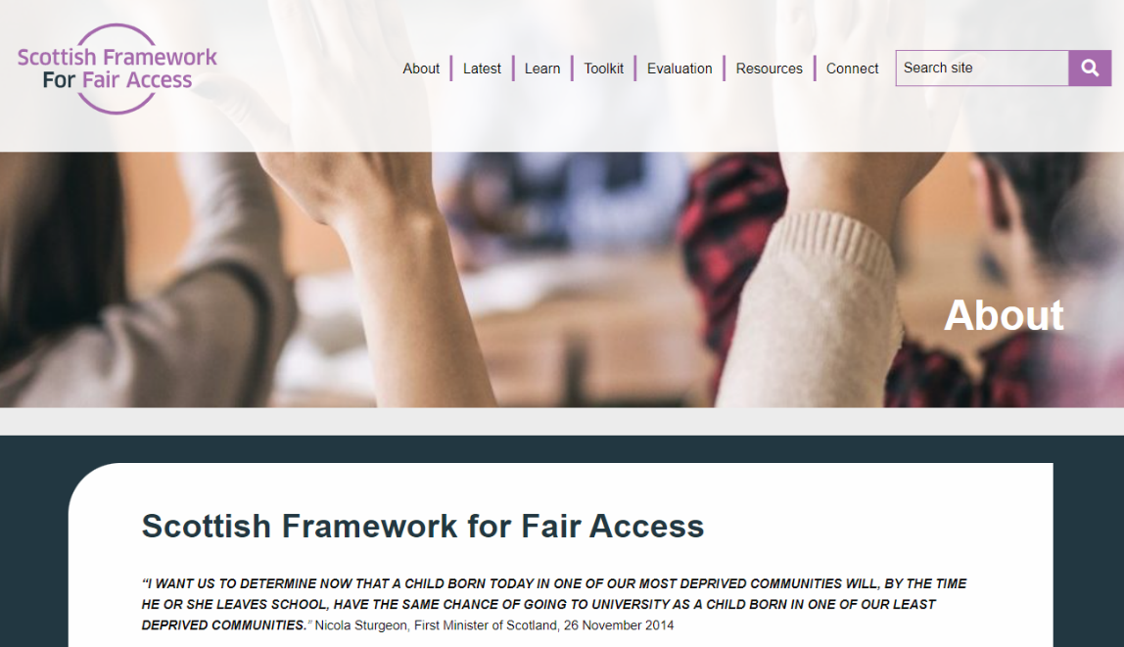
Scottish Framework for Fair Access

Slide 6
SCAPP Aims
Aims
To provide a practitioners’ network to support the development and professionalisation of a strong WA and WP community in Scotland
To be inclusive and system wide
To be sustainable and member-led
4. Build on, not duplicate existing national and local networks

Slide 7
SCAPP Objectives
Objectives
Offering networking opportunities via sharing practice, resources and skills
Creating training, learning and development opportunities
Ensuring quality of practice and accreditation framework
Developing effective mechanisms between research and practice
Encouraging input, contribution and promotion of Fair Access Toolkit

Slide 8
Progress and challenges
1. Building membership/maintaining and sustaining membership
2. Building communication and making connections/identifying
communities and working together
3. Webinars and events/keeping them relevant, accessible and useful
4. Working Groups

Slide 9
Working and CoP Groups
1. Learning and Development Working Group
Professional Standards Framework and Accreditation Scheme
MAPS – Mentoring Programme
Ongoing activities and new developments
2. Evaluation and Research Working Group
Build links between research and practitioner communities
Development of Guide to Evaluation for WA and WP practitioners
Directory of Networking and Expertise
3. Events and Communication Team
Network and events management
Build social media presence and digital footprint
4. Articulation Working Group
Articulation Matters, Events, taking forward work from the National Articulation Forum
5. Community of Practice – The Sanctuary Group

Slide 10
Evaluation and Research Working Group
Build links between research, evaluation and practitioner communities
To develop the capacity of practitioners working in the field of widening access to utilise evaluation and research to provide:
a better understanding for practitioners, funders and stakeholders of what works in the field of widening access
information and research in the field, so that practitioners can develop capacity to further develop widening access evaluation research
a focus on enhancing current work, for example developing effective frameworks for evaluation and with an increasing focus on online evaluation as a result of Covid-19
opportunities to share practice widely via events
Barriers
Identified Resource Gap – knowledge, expertise, time, money.
Solution
Practical and accessible ‘How To’ Guide to WP Evaluation.
Development of Directory of Networking and Expertise

Slide 11
Gaps in evaluation capacities identified by access and participation practitioners
Time for evaluation
Expertise to confidently produce the robust evaluation research needed
Access to data
Practical guidance around:
Evaluation design e.g. how to design evaluation that is robust but realistic in practice?
Evaluation methodologies e.g. which approaches to use and how?
Data collection e.g. am I gathering meaningful data?
Ethics e.g. do I need approval and how do I get it? GDPR compliance?
Data analysis e.g. how to use the appropriate statistical analysis?
Presenting findings e.g. best formats for different audiences?

Slide 13
Widening Participation Evaluation Guide
Widening Participation Evaluation Guide

Slide 14
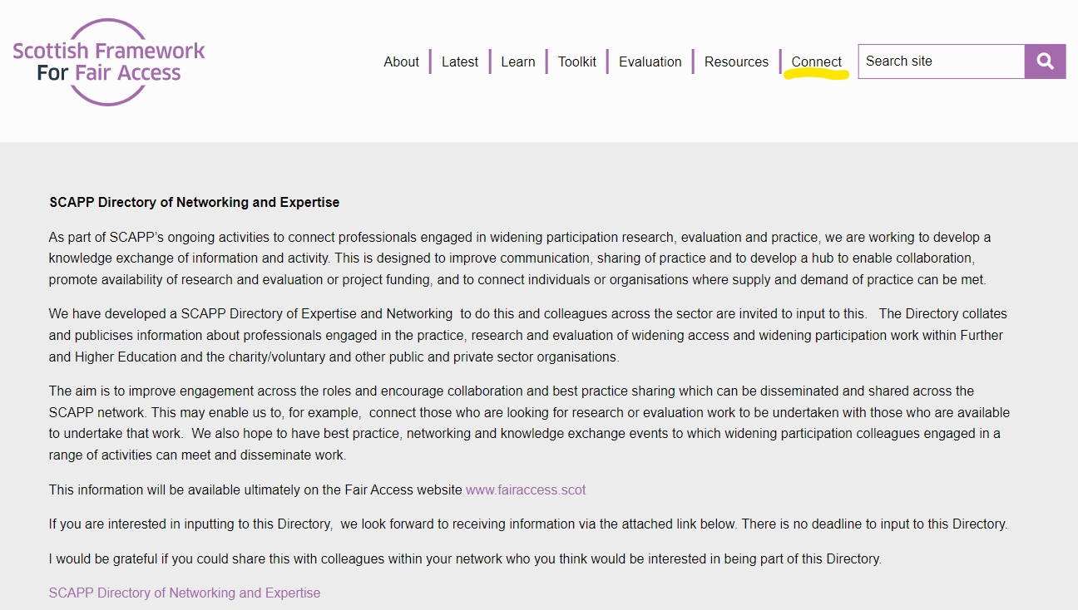

Slide 15
For Discussion
What practice exists in your own institution which demonstrates that Widening Access and Widening Participation activities work?
Are there ways that we can develop this further?
What resources, if any, does your institution currently use for evaluating your Widening Access and Widening Participation activities
What Professional Development, if any, do you, or your department/team/institution need, to undertake Widening Access and Widening Participation evaluation, research and development work

Slide 16
Contact details
Muriel.alexander@stir.ac.uk
swapwest@scottishwideraccess.org

Slide 17
CLOSING COMMENTS
NEXT STEPS

Slide 18
Scotland’s Community of Access and Participation Practitioners scapp@stir.ac.uk www.fairaccess.scot

