Slide 1
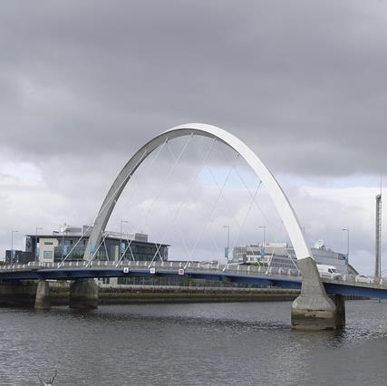
Higher education micro-credentials in Scotland
QAA Scotland Collaborative Cluster
Anne Tierney, Heriot-Watt University
a.Tierney@hw.ac.uk

Slide 2
QAA Enhancement Themes Project
Collaborative cluster involving 11 HEIs in Scotland and JISC
Seeking to understand the potential benefits that microcredentials could afford to all stakeholder
- students
- university staff
- employers
- employees/alumni,
But need to make sure that these stakeholders have a good understanding.
Cluster has 4 inter-institutional teams each investigating one of the stakeholder groups
- stakeholder events
- questionnaires.

Slide 3
Stakeholder Groups
EMPLOYERS
Joy Perkins (Aberdeen)
Mary Pryor (Aberdeen)
Sam Thornton(Jisc)
STAFF
Morven Shearer (St Andrews)
Sally Smith (Edinburgh Napier)
Anne Tierney (HWU)
Robin Westacott (HWU)
CUSTOMERS
John Kerr (Glasgow)
Nicola Milton (St Andrews)
Julie Strachan (RGU)
STUDENTS
Katrina Swanton (Edinburgh Napier)
Alen MacKinlay (GCU)
Luke Millard (Abertay)

Slide 4
Priorities – what matters to the stakeholders?
Language
Accreditation
University/Industry partnerships
Flexibility
Recognising the potential

Slide 5
Summary
Microcredentials and Digital Badges are attractive to all stakeholders
Need common terminology and accepted QA Framework
Follow on from Collaborative Cluster project to investigate and develop.

