Slide 1
Strathclyde Student Resilience Toolkit
Dr Rosanne English and Prof Debra Willison
University of Strathclyde
QAA ENHANCEMENT CONFERENCE 2022: RESILIENT LEARNING COMMUNITIES

Slide 2
What we did
4 student interns over summer 2021
One from each faculty; Humanities and Social Sciences, Science, Business, Engineering
Review of existing resources for student resilience
Survey of students on their experiences with resilience
Student development of resources for students to use to develop their resilience

Slide 3
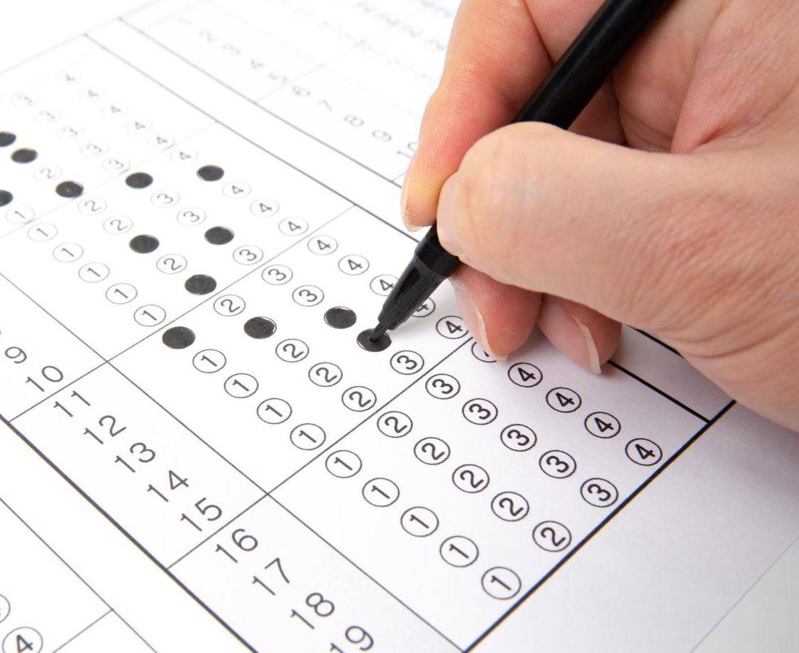
Perceptions of Resilience Survey 189 Responses

Slide 4
What is Resilience?

Slide 5
Methods for Resilience
Music
Exercise
Therapy
Support from friends and family

Slide 6
Level of Study Distribution

Slide 7
Faculty Distribution

Slide 8
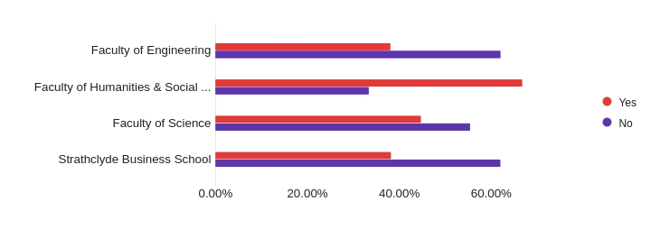
Resilience Strategies by Faculty

Slide 9
Null Hypotheses Accepted
No correlation between year of study and perceived level of personal resilience
No correlation between year of study and strategies
No correlation between Faculty of study and strategies
No correlation between Faculty of study and perceived level of personal resilience
No correlation between having strategies and perceieved level of resilience

Slide 11
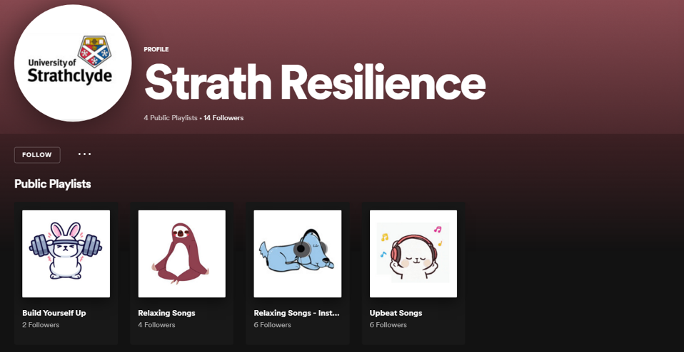
Resource Development- Musical

Slide 12
Resource Development – Presentations and Posters

Slide 13
Resource Development – Worksheets and Additional Resources

Slide 14
Evaluation and Next Steps

